Slide 1
Introduction to Blockchain Technologies
Notes:
Python for Tool Developers
1

Slide 2
Course Program
Module 1 – Quick Overview
Module 2 – Usage
Module 3 – Introduction to the Blockchain
Module 4 – Mining and Transactions
Module 5 – Centralized and Decentralized Blockchains
Module 6 – Conclusions
2
Python for Tool Developers
Notes:
Python for Tool Developers
2

Slide 3
Module 1
Quick Overview
3
Notes:
Python for Tool Developers
3

Slide 4
BlockChain History
The Blockchain and its first use case, Bitcoin introduced in January 2009
Founder was Satoshi Nakamoto. However, Satoshi Nakamoto is a pseudonym.
No one knows who the true inventor of the Blockchain is.
The blockchain is built on the foundations of many other technologies.
4
Python for Tool Developers
Notes:
Blockchain History
The blockchain was first presented to the world in January, 2009 by a person or persons known only as Satoshi Nakamoto, which is a pseudonym.
The first information recorded on the Blockchain was the headline in the Times of London on January 3, 2009 entitled:
“Chancellor Alastair Darling on brink of second bailout for banks.”
The blockchain was built on the foundations of many different technologies, including:
Hashcash by Adam Back
Merkle Trees by Ralph Merkle
Secure Cryptographic Hashing
Bloom Filters
And many others.
This would give us a new list where each number is a square of the original. However, Python gives us a much easier way to write this:
This new construct is a List Comprehension. This is a fast, and powerful way to create new lists. Additionally, it produces faster python code than the original code above.
Python for Tool Developers
4
originalList=[2,4,,8,10,12,14,16,18,20]
newList = []
for number in originalList:
newlist.append(number * number)
originalList = [2,4,6,8,10,12,14,16,18,20]
newList = [number * number for number in OriginalList]

Slide 5
Blockchain Decentralization
The blockchain is designed as a decentralized peer to peer (P2P) application.
The first real world use case was Bitcoin.
The Bitcoin blockchain is permissionless. No individual, group, organization, corporation or government controls the information on the Blockchain.
The only people allowed to write into the Blockchain are the miners.
The blockchain is read-only for all others.
5
Python for Tool Developers
Notes:
Blockchain Decentralization
The original Bitcoin blockchain was designed as a decentralized, peer to peer application where no one organization has control over it.
There is no requirement to join, nor any requirement to participate in the network.
The only people allowed to write into the blockchain are the ‘miners’, who are required to solve a particular difficult math problem in order to obtain the rights to store a new block onto the blockchain.
The blockchain is read only for all others. In addition to the miners, there are also validation nodes which validate the transactions on the network as well as client application which allow users to participate in the network.
Python for Tool Developers
5
Celsius = (37.4,23.2,11.5,2.7)
Fahrenheit= [ ((float(9) / 5) * temp + 32) for temp in Celsius]
noprimes = [j for i in range(2,8) for j in range(i*2,100,i)]
primes = [x for x in range(2,100) if x not in noprimes]

Slide 6
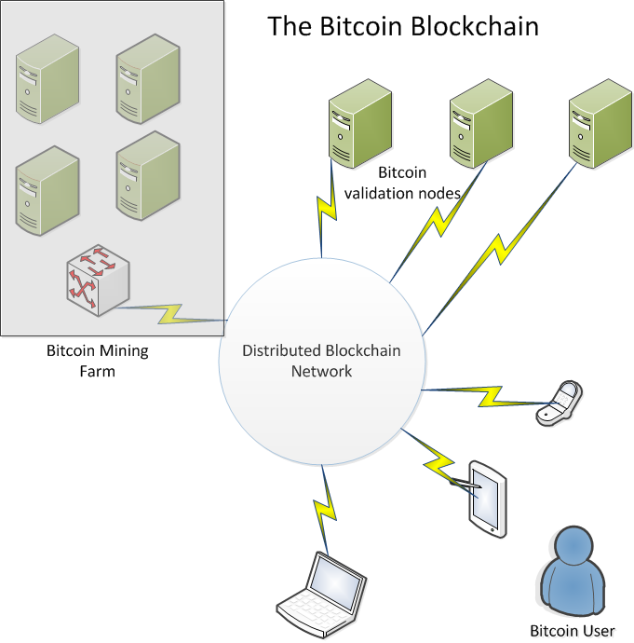
Blockchain Decentralization
6
Python for Tool Developers
Notes:
Python for Tool Developers
6
Celsius = (37.4,23.2,11.5,2.7)
Fahrenheit= [ ((float(9) / 5) * temp + 32) for temp in Celsius]
noprimes = [j for i in range(2,8) for j in range(i*2,100,i)]
primes = [x for x in range(2,100) if x not in noprimes]

Slide 7
Blockchain Permissioning.
The original blockchain for Bitcoin was designed as a permissionless system.
No requirements were needed to join.
Data is transparent. All transactions on the Bitcoin blockchain are visible to everyone on the network.
Lately, other types of Blockchains have emerged. Notably Hyperledger which is sponsored by IBM and other large corporations.
7
Python for Tool Developers
Notes:
Blockchain Decentralization
The original Bitcoin blockchain was designed as a decentralized, peer to peer application where no one organization has control over it.
There is no requirement to join, nor any requirement to participate in the network.
The blockchain was designed as a transparent distributed database. All transactions going back to the initial ‘genesis’ transaction by Satoshi Nakamoto are visible on the Blockchain.
Some organizations view this as a drawback, so the concept of a ‘permissioned’ Blockchain which allows for more validation of users and tighter control over the system have emerged, for example, the Hyperledger project which is backed by a number of Fortune 500 companies including IBM.
Python for Tool Developers
7
Celsius = (37.4,23.2,11.5,2.7)
Fahrenheit= [ ((float(9) / 5) * temp + 32) for temp in Celsius]
noprimes = [j for i in range(2,8) for j in range(i*2,100,i)]
primes = [x for x in range(2,100) if x not in noprimes]

Slide 8
Theoretical Background
A blockchain transactions works as follows
A transaction is requested
This request is send over the P2P network to the ‘nodes’ or computers on the network
The nodes create a ‘block’ on the blockchain which includes your transaction.
Other nodes on the network validate the transaction within the block.
8
Python for Tool Developers
Notes:
When someone wishes to transact on the blockchain the following sequence of events occurrs.
The user requests a transaction through some interfacing software (usually known as a Blockchain wallet).
The wallet software broadcasts the transaction to the network, which stores it in a ‘pool’ of pending transactions
A miner successfully creates a block on the blockchain and includes the users transaction in the block.
The validation nodes verify the ‘correctness’ of the transaction and broadcast this out over a P2P system so that all
nodes on that network now have a record of that transaction in the blockchain ‘ledger’.
This is the concept of ‘distributed consensus’.
Python for Tool Developers
8
def f(x,n):
return(x+n)
g = lambda x,n: x+n
print (f(1,2))
print (g(1,2))

Slide 9
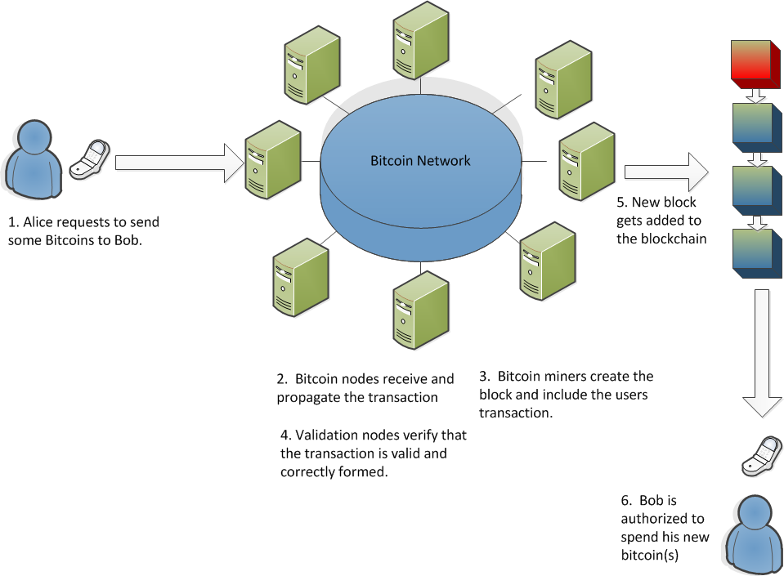
Theoretical Background
9
Python for Tool Developers
Notes:
Python for Tool Developers
9
def f(x,n):
return(x+n)
g = lambda x,n: x+n
print (f(1,2))
print (g(1,2))

Slide 10
Blockchain use cases
The first and most visible use case for the blockchain is for cryptocurrencies.
The ability to create and store digital tokens of value is hugely disruptive to the financial community.
The blockchain offers many exciting opportunities to innovate and create value propositions for consumers.
10
Python for Tool Developers
Notes:
Blockchain Use Cases
Bitcoin was the first use case for Cryptocurrencies and is still by far the most visible. The ability to create and store digital tokens that retain value and cannot be arbitrarily duplicated is a huge milestone for the financial technology community.
Many new companies have sprung up to take advantage of this new technology to form real value propositions for consumers and investors.
Examples of companies include:
Coinbase. A Bitcoin exchange based in San Francisco
Unocoin. An Indian based cryptocurrency exchange based in Mumbai.
BitPesa. A bitcoin remittance service based in Kenya that allows currency remittances in local currencies in Africa.
Python for Tool Developers
10
def f(x,n):
return(x+n)
g = lambda x,n: x+n
print (f(1,2))
print (g(1,2))

Slide 11
Blockchain use cases
Other use cases include strengthened Know Your Customer/Anti-Money Laundering (KYC/AML) systems.
Trading Platforms. Many exchanges, including NASDAQ are rolling out trading exchanges based on blockchain technology.
Payments. The remittance and payments sector is being actively disrupted by companies offering the blockchain as a method for conducing cross-nation, global payments.
11
Python for Tool Developers
Notes:
Blockchain Use Cases
KYC/AML compliance is becoming increasingly important in today’s global financial community. The need to fight both terrorism and organized criminal groups requires that financial institutions implement strict KYC/AML regulations. However, this implementation can come at a high cost. A Thomson/Reuters study showed that financial institutions were spending at least 60 million USD per year on regulation, with some organizations paying as much as 500 million USD per year on compliance.
There are proposals to store institutional KYC statements on a distributed blockchain ledger. Once the client has been verified, the information can placed securely on the blockchain and available by other financial institutions and accredited organizations, such as insurance companies or loan providers without the need for duplication of KYC effort. The blockchain guarantees the provisioning of the data so that other institutions no longer need to repeat the costly KYC checks.
Trading Platforms.
A key use for blockchain technologh is in the area of securities exchanges. With a blockchain, the need for a centralized trust system or an intermediary is obviated. Additionally, there is no risk of a double spend in the supply chain.
Additionally, the risks of fraud and errors would be significantly reduced since the blockchain makes the entire process transparent, secure and immutable. A clear audit trail of all trades becomes available to all parties, which provides legal and financial assurances of transaction authenticity.
A digital token would act as a certificate of authenticity so it makes forging of securities nearly impossible as opposed to dealing with paper documents. This would give securities a level of verifiable trust that is currently unavailable.
NASDAQ and the Australian Securities Exchange are busily developing blockchain-based exchanges to implement the noted features.
Payments
The blockchain can be used as a new way for both existing institutions and startup financial technology companies to facilitate payments between principals that does not depend on SWIFT or other existing payment scheme.
Using the blockchain to facilitate payments can reduce the amount of time spend between the first principal sending the payment and the second principal receiving the payment from days or weeks to minutes and hours. Additionally, the security of cross-border payments would be substantially increased.
One example of this is Ripple, a blockchain-based payment system designed for banks. Ripple is an open source blockchain that allows banks to make payments in a real time to counterparties without the need for intermediaries. The blockchain allows for real-time execution, transparency, fraud protection performed in real-time and at a much lower cost than with traditional methods
Python for Tool Developers
11
def f(x,n):
return(x+n)
g = lambda x,n: x+n
print (f(1,2))
print (g(1,2))

Slide 12
Blockchain use cases
Management of intellectual property. The Blockchain is being used to identify ownership rights for intellectual property such as music and other artistic works.
Insurance. The blockchain can solve many current problems that exist in the insurance industry.
Smart contracts (Ethereum). A relatively new innovation is the ability for the blockchain to run software as well as store data securely. The Ethereum blockchain is an example of this.
12
Python for Tool Developers
Notes:
Blockchain Use Cases
Management of intellectual property.
Digital rights expression is one of the biggest problems the music industry is tackling presently. It’s extremely difficult to clearly define which performers, songwriters, producers, publishers, and labels own the rights to songs and recordings and how royalties should be split between them.
This is an area where the blockchain can effect major changes. The blockchain ledger stores a cryptographic hash representing the digital content of every new song registered on the blockchain, along with lyrics, musical composition, liner notes, cover art, licensing, and other relevant information.
Since they are immutable distributed ledgers and are not owned by any single entity, blockchains will allow content creators to register ownership of their creations without the need for big record labels or other intermediaries.
The blockchain can also solve the problem of how content creators are paid for their work.
Currently, a string of publishers, record labels, talent agencies, streaming services, etc., each take a cut of revenue before passing any remaining amounts along to artists — after a 6- to 18-month delay.
The blockchain should allow royalties to flow directly through to the creators without the need for these intermediaries via the use of Smart Contracts, which are software applications executed directly on the blockchain.
Insurance.
The blockchain will allow insurance to make radical gains in efficiency in many areas of the business. For example :
Claims Registration.
to provide trusted and verified submission of claims data and documentation.
Enable automated pre-assessment of loss coverage against the insurancce policy.
Automate the process to engage repair and assistance proviceres to reduce response time and ensure use of preferred and trusted suppliers.
Claims assessment
To allow access to validated external data through trusted sources.
Enable automated determination of loss liability
Enable automated assessment of loss coverage for reinsurance.
Enable programmable escalation to human decision making in the case of complex risks.
Payment and closure,
To provide automatic payment to insurees through smart contracts.
To provide immutable and transparent proof of claim settlement.
Smart contracts
The ethereum blockchain pioneered the concept of a Smart Contract. Whereas blockchains such as bitcoins only allowed data storage on the blockchain, Ethereum allows users to write software and store and execute it directly on their blockchain. This innovation will allow users to write contracts and, indeed, entire applications using the Blockchain without the need for human intermediaries.
Smart contracts will allow a whole hosts of activities to be digitized, including financial derivatives, insurance contracts, and many other types of instruments.
Python for Tool Developers
12
def f(x,n):
return(x+n)
g = lambda x,n: x+n
print (f(1,2))
print (g(1,2))

Slide 13
Blockchain use cases
Application development. Many companies are in the process of developing applications on the Ethereum network and others to automate business preocesses.
Additionally, there is a lot of activity around the concept of Dapps or DAO’s, which are Distributed Autonomous Organizations which exist only on the blockchain.
IBM has its own blockchain that they are working on called Hyperledger in conjunction with the Linux foundation and other large organizations.
13
Python for Tool Developers
Notes:
Blockchain Use Cases
Management of intellectual property.
Digital rights expression is one of the biggest problems the music industry is tackling presently. It’s extremely difficult to clearly define which performers, songwriters, producers, publishers, and labels own the rights to songs and recordings and how royalties should be split between them.
This is an area where the blockchain can effect major changes. The blockchain ledger stores a cryptographic hash representing the digital content of every new song registered on the blockchain, along with lyrics, musical composition, liner notes, cover art, licensing, and other relevant information.
Since they are immutable distributed ledgers and are not owned by any single entity, blockchains will allow content creators to register ownership of their creations without the need for big record labels or other intermediaries.
The blockchain can also solve the problem of how content creators are paid for their work.
Currently, a string of publishers, record labels, talent agencies, streaming services, etc., each take a cut of revenue before passing any remaining amounts along to artists — after a 6- to 18-month delay.
The blockchain should allow royalties to flow directly through to the creators without the need for these intermediaries via the use of Smart Contracts, which are software applications executed directly on the blockchain.
Insurance.
The blockchain will allow insurance to make radical gains in efficiency in many areas of the business. For example :
Claims Registration.
to provide trusted and verified submission of claims data and documentation.
Enable automated pre-assessment of loss coverage against the insurancce policy.
Automate the process to engage repair and assistance proviceres to reduce response time and ensure use of preferred and trusted suppliers.
Claims assessment
To allow access to validated external data through trusted sources.
Enable automated determination of loss liability
Enable automated assessment of loss coverage for reinsurance.
Enable programmable escalation to human decision making in the case of complex risks.
Payment and closure,
To provide automatic payment to insurees through smart contracts.
To provide immutable and transparent proof of claim settlement.
Smart contracts
The ethereum blockchain pioneered the concept of a Smart Contract. Whereas blockchains such as bitcoins only allowed data storage on the blockchain, Ethereum allows users to write software and store and execute it directly on their blockchain. This innovation will allow users to write contracts and, indeed, entire applications using the Blockchain without the need for human intermediaries.
Smart contracts will allow a whole hosts of activities to be digitized, including financial derivatives, insurance contracts, and many other types of instruments.
Python for Tool Developers
13
def f(x,n):
return(x+n)
g = lambda x,n: x+n
print (f(1,2))
print (g(1,2))

Slide 14
Module 2
Introduction to the Blockchain
14
Notes:
Python for Tool Developers
14

Slide 15
Introduction to the blockchain
The primary purpose of the blockchain is to facilitate secure storage and retrieval of data.
The blockchain does this by constructing a series of blocks, which are really just data structures containing a list of transactions.
These blocks have a link to the previous block, hence providiing a chain of blocks that extend back to the first block created on the blockchain.
15
Python for Tool Developers
Notes:
The blockchain is effectively a list of blocks that contain multiple transactions collected together. The blocks are linked to each other in a backward fashion, that is to say, the last block in the chain points to the previous block, which points back to the one before that, and so on, back to the initial block in the blockchain, known as the genesis block.
Most blocks today are created using a concept called proof of work With proof of work, a person or a group called miners solve a difficult problem created by the blockc hain system. Once this problem is solved, the miner is allowed to submit a block of transactions to the network for validation. In the first transaction of the block, a reward token is granted to the miner. This is how new digital tokens are created on the network and how transactions are submitted to the network.
Python for Tool Developers
15
def f(x,n):
return(x+n)
g = lambda x,n: x+n
print (f(1,2))
print (g(1,2))

Slide 16
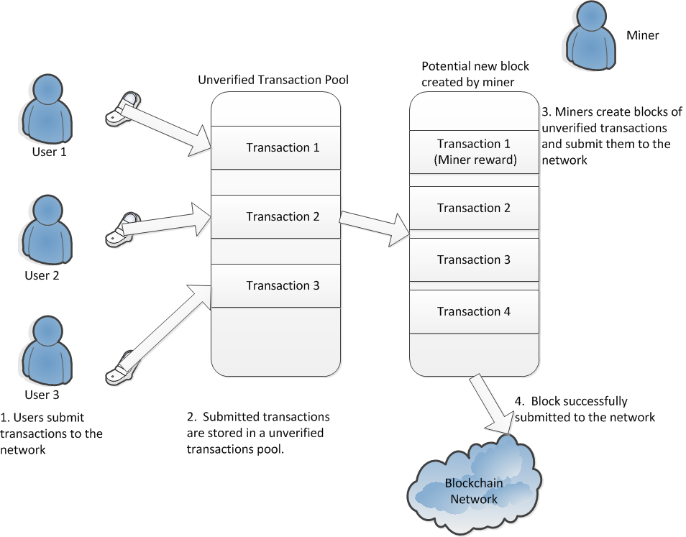
Introduction to the blockchain
16
Python for Tool Developers
Notes:
Python for Tool Developers
16
def f(x,n):
return(x+n)
g = lambda x,n: x+n
print (f(1,2))
print (g(1,2))

Slide 17
Introduction to the blockchain
Bitcoin transactions are stored as unspent transaction outputs.
In order to spend bitcoin, you must prove that you own these outputs by using a cryptographic key that you own.
Once the bitcoin are sent to another user, they have to prove that they are that user by providing their own cryptographic key.
Transactions are stored on the blockchain as a record of inputs and outputs.
17
Python for Tool Developers
Notes:
Bitcoins are not perfectly fungible… when you move (or spend) them, you’re spending some specific bitcoins
In order to spend them, you have to prove you’re entitled to do so. And you do that by providing the solution to a challenge that was laid down when they were sent to you in the first place. This challenge is usually just: “prove to the world that you know the public key that corresponds to a particular Bitcoin address and are in possession of the corresponding private key”. But it can be more sophisticated than that.
When you send Bitcoins somewhere, you lay down the challenge for the next owner. Usually, you’ll simply specify that they need to know the public and private keypair that correspond to the Bitcoin address the coins were sent to. But it can be more complicated than that. In the general case, you don’t even know who the next owner is… it’s just whoever can satisfy the condition.
Python for Tool Developers
17
def f(x,n):
return(x+n)
g = lambda x,n: x+n
print (f(1,2))
print (g(1,2))

Slide 18
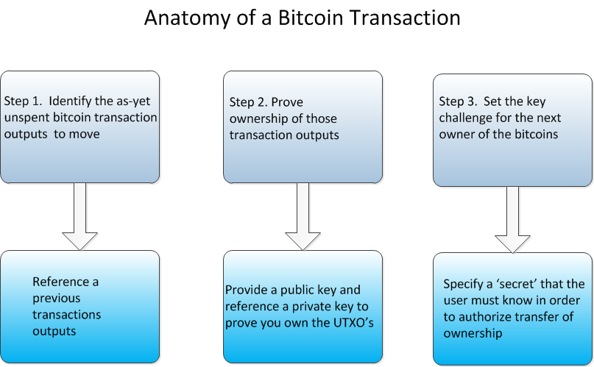
Introduction to the blockchain
18
Python for Tool Developers
Notes:
Python for Tool Developers
18
def f(x,n):
return(x+n)
g = lambda x,n: x+n
print (f(1,2))
print (g(1,2))

Slide 19
Introduction to the blockchain
The bitcoin proof of work algorithm is known in computer science as an NP problem. (NP stands for non polynomial)
Problems of this type grow exponentially more difficult as the complexity of the problem increases.
NP problems have no algorithmic shortcuts for efficiency.
An example of an NP problem is a crossword puzzle, which increases in difficulty exponentially as the size of the words in the puzzle increases.
19
Python for Tool Developers
Notes:
Python for Tool Developers
19
def f(x,n):
return(x+n)
g = lambda x,n: x+n
print (f(1,2))
print (g(1,2))

Slide 20
Introduction to the blockchain
Bitcoin proof of work algorithm leads to some level of centralization in the form of miners, which now require specialized hardware and massive amounts of capital to successfully mine blocks.
This is contrary to the spirit of a decentralized consensus system envisioned by Satoshi Nakamoto
The ethereum proof of work does not require specialized hardware to solve, so it is a more democratic solution
20
Python for Tool Developers
Notes:
Python for Tool Developers
20
def f(x,n):
return(x+n)
g = lambda x,n: x+n
print (f(1,2))
print (g(1,2))

Slide 21
Introduction to the blockchain
There exists two general types of blockchains, permissioned and unpermissioned.
The only real difference between the two is that permissioned blockchains restrict who can participate in the distributed consensus mechanism.
Permissioned blockchains allow the network to appoint a group of authorized participants who are allowed to validate the blocks.
Additionally, smart contracts can be restricted by the participants.
21
Python for Tool Developers
Notes:
The “DNA” of a permissioned blockchain network is no different than the “DNA” of an unpermissioned blockchain network. With the exception of one gene that has been mutated.
Properly permissioned blockchain networks differ from unpermissioned blockchain networks solely based on the presence (or absence) of an access control layer built into the blockchain nodes.
The first primary difference between a properly conceived permissioned blockchain network and an unpermissioned blockchain network is whether the participants in the network have an ability to restrict who can participate in the consensus mechanism of the blockchain’s network.
Permissioned blockchain networks allow the network to appoint a group of participants in the network who are given the express authority to provide the validation of blocks of transactions. Or, to participate in the consensus mechanism.
The second primary difference between a properly conceived permissioned blockchain network and an unpermissioned blockchain network is whether the participants in the network have an ability to restrict who can create smart contracts (if the blockchain node is logic optimized) and/or transact on the blockchain network.
Python for Tool Developers
21
def f(x,n):
return(x+n)
g = lambda x,n: x+n
print (f(1,2))
print (g(1,2))

Slide 22
Introduction to the blockchain
Permissioned blockchains usually perform better than permissionless blockchains.
Permissioned blockchains limit the type of transactions that can be created and validated.
Permissioned blockchains allow the network to appoint a group of authorized participants who are allowed to validate the blocks.
Additionally, smart contracts can be restricted by the participants.
22
Python for Tool Developers
Notes:
Blockchain networks in general are not very performant. But one can get better performance from a single blockchain network by limiting what that network is actually trying to manage. In any blockchain network, all the full nodes on the network perform all of the computation redundantly rather than in a segregated (traditional parallel computing) fashion.
So, when one is running a full node on a public blockchain network one is performing all of the computation for all of the applications running on the entire network. Should that single blockchain network explode in popularity, this will be a ton of computing power you would devote to managing the computational effort for applications other than the one you are trying to use.
This doesn’t make sense for every application. Particularly those applications which are enterprise in nature and need to have increased performance.
Permissioned blockchain networks do not abrogate the requirement that every full node on the network perform all of the computation for all of the network. Effectively these networks are breaking the computation requirements for a given meta-network into segments which only apply to that particular application.
A permissioned blockchain network will be more performant than an unpermissioned blockchain network for a given application because each node will only need to perform the computation necessary to support that given application, but it will also be significantly slower than scripting languages and hub and bespoke databases.
Python for Tool Developers
22
def f(x,n):
return(x+n)
g = lambda x,n: x+n
print (f(1,2))
print (g(1,2))

Slide 23
Introduction to the blockchain
Sidechains are spin-offs from the Bitcoin blockchain.,
Sidechains have their own blockchain, with their own properties.
Users can send bitcoins to a special address, which locks the bitcoins and transfers them to a new blockchain
Transfers are symmetrical.
Examples of sidechains are Mastercoin
23
Python for Tool Developers
Notes:
Sidechains are specialized blockchains that peg to the Bitcoin blockchain. They arose out of a need to experiment with blockchains that have different properties than Bitcoin. For example, the Bitcoin blockchain propagates new blocks approximately every ten minutes. For some people, that isn’t really fast enough, so sidechains are a way of creating new blockchains and still be able to use Bitcoins.
To use a sidedchain you send your Bitcoins to a specially formed Bitcoin address. The address is specially designed so that the coins will now be out of anyone’s control. They’re completely frozen and can only be unlocked if somebody can prove they’re no longer being used elsewhere .
Once this immobilisation transaction is sufficiently confirmed, a message is sent to the other blockchain. This message contains a proof that the coins were sent to that special address on the Bitcoin network, that they are therefore now immobilized by you.
The sidechain then creates the exact same number of tokens on its own network and gives you control of them.
You can now transact with those coins on that second chain, under whatever rules that sidechain chooses to implement.
For example, the new sidechain could propagate blocks faster than the approximate ten minute limit that the Bitcoin blockchain implements. Or the new sidechain could have transaction scripts that are more full-featured than the Bitcoin transaction script, or other features not yet implemented by the Bitcoin blockchain. The one thing that all of these sidechains have in common is that they follow the convention that if you have sent Bitcoin to a specific address and immobilized them, then the same number of tokens appear on the sidechain.
These transactions are symmetrical. So, at any point, whoever is holding these coins on the sidechain can send them back to the Bitcoin network by creating a special transaction on the sidechain that immobilises the bitcoins on the sidechain. They’ll disappear from the sidechain and become available again on the Bitcoin network, under the control of whoever last owned them on the sidechain.
Python for Tool Developers
23
def f(x,n):
return(x+n)
g = lambda x,n: x+n
print (f(1,2))
print (g(1,2))

Slide 24
Module 4
Mining and Transactions
24
Notes:
Python for Tool Developers
24

Slide 25
Mining and Transactions
The blockchain is a solution to a classic problem known as the ‘Byzantine Generals Problem’
In this problem several armies surround a castle hoping to sack it.
Each army is led by a separate general.
Only a coordinated attack will ensure victory
No centralized communication. Messages are passed between generals. Some generals, however, are traitors.
25
Python for Tool Developers
Notes:
The Blockchain provides a solution to the Byzantine General’s Problem.
In this problem, several army factions surround a castle they hope to sack. A general leads each faction and one general is the lead general
Only a simultaneous attack ensures victory. Also, since the factions surround the castle, they are dispersed, making centralized command difficult.
The generals must send messages between the factions to relay the attack time. However, some generals are traitors and will not obey the command and worse, will relay the wrong attack time to the other generals. The generals do not know who is loyal and who is a traitor and there is no way to find out.
So, how do the factions ensure a coordinated attack to sack the castle?
Let’s apply this scenario to the Blockchain. In a distributed ledger, any inputs (the messages) to the ledger (the agreed upon time of attack) must be trusted. Digital networks usually have millions of members (the generals) who are dispersed globally and there is no centralized command (no central governance), and it is impossible for you to know all the members. So how can you trust the other members of the network and ensure that the inputs to the distributed ledger are accurate and moreover, ensure that the ledger itself has the correct information? The Blockchain solves this problem and in the case of our Byzantine general, ensures that he can send trusted messages and lead a successful coordinated attack.
Python for Tool Developers
25
def f(x,n):
return(x+n)
g = lambda x,n: x+n
print (f(1,2))
print (g(1,2))

Slide 26
Mining and Transactions
The blockchain provides a decentralized, self-governing network (no intermediaries)
The network is trusted despite the lack of a central governing organization.
Blockchains maintain a digital ledger (a distributed database of all its recorded transactions). All transactions are recorded. No transaction can be deleted. The ledger is updated as new transactions occur.
Each node in the blockchain must agree on all proposed updates.
26
Python for Tool Developers
Notes:
Since bitcoin is the most prominent use of blockchain, let’s examine the bitcoin protocol to help us understand blockchain. In fact, the decentralization and self-governance of bitcoin is only possible because of blockchain.
Just as banks maintain a transaction ledger, the bitcoin blockchain maintains a digital ledger (imagine a database of all recorded transactions) that has recorded every single bitcoin transaction of every single bitcoin in history and updates this ledger whenever new transactions occur.
A copy of the bitcoin ledger is distributed on a network of computers (nodes). In order for any updates to be made to the ledger, each node must agree on the proposed update. So how does this process happen?
If I want to pay you for a transaction using bitcoin, we both need to have a bitcoin wallet (software which connects to the bitcoin ledger). My bitcoin wallet tells the ledger to record the transaction of removing bitcoin from my wallet and adding the corresponding bitcoin into your wallet. For this update to take place, every network node (computer) examines the existing ledger to ensure the transaction is legitimate (i.e. do I actually have the bitcoin I want to give to you?). Once the node verifies the legitimacy of the transaction, it becomes part of a queue of other verified transactions and this queue forms the next potential block in the blockchain. In order for the new transactions to be approved by the network, the nodes try to solve a computational puzzle known as ‘the-proof-of-work’. Nodes that try to solve the puzzle are called ‘miners’. Once a miner solves the puzzle, it sends the solution to the rest of the network for verification. If the solution is verified, the new block is added to the blockchain.
Since the new block must be approved by the entire network it is a trusted addition to the ledger and the header authenticates the accuracy of each block. The ledger itself is a chain of these trusted blocks, so the entire ledger is also trusted.
Python for Tool Developers
26
def f(x,n):
return(x+n)
g = lambda x,n: x+n
print (f(1,2))
print (g(1,2))

Slide 27
Mining and Transactions
The blockchain provides a decentralized, self-governing network (no intermediaries)
The network is trusted despite the lack of a central governing organization.
Blockchains maintain a digital ledger (a distributed database of all its recorded transactions). All transactions are recorded. No transaction can be deleted. The ledger is updated as new transactions occur.
Each node in the blockchain must agree on all proposed updates.
27
Python for Tool Developers
Notes:
Since bitcoin is the most prominent use of the blockchain, let’s examine the bitcoin protocol to help us understand the blockchain. In fact, the decentralization and self-governance of bitcoin is only possible because of the blockchain.
Just as banks maintain a transaction ledger, the bitcoin blockchain maintains a digital ledger (imagine a database of all recorded transactions) that has recorded every single bitcoin transaction of every single bitcoin in history and updates this ledger whenever new transactions occur.
A copy of the bitcoin ledger is distributed on a network of computers (nodes). In order for any updates to be made to the ledger, each node must agree on the proposed update. So how does this process happen?
If I want to pay you for a transaction using bitcoin, we both need to have a bitcoin wallet (software which connects to the bitcoin ledger). My bitcoin wallet tells the ledger to record the transaction of removing bitcoin from my wallet and adding the corresponding bitcoin into your wallet. For this update to take place, every network node (computer) examines the existing ledger to ensure the transaction is legitimate (i.e. do I actually have the bitcoin I want to give to you?). Once the node verifies the legitimacy of the transaction, it becomes part of a queue of other verified transactions and this queue forms the next potential block in the blockchain. In order for the new transactions to be approved by the network, the nodes try to solve a computational puzzle known as ‘the-proof-of-work’. Nodes that try to solve the puzzle are called ‘miners’. Once a miner solves the puzzle, it sends the solution to the rest of the network for verification. If the solution is verified, the new block is added to the blockchain.
Since the new block must be approved by the entire network it is a trusted addition to the ledger and the header authenticates the accuracy of each block. The ledger itself is a chain of these trusted blocks, so the entire ledger is also trusted.
Python for Tool Developers
27
def f(x,n):
return(x+n)
g = lambda x,n: x+n
print (f(1,2))
print (g(1,2))

Slide 28
Mining and Transactions
The security of the blockchain is the paramount issue in cryptocurrency and other blockchain applications.
Distributed consensus maintains this security.
With distributed consensus interested parties do not need to know or trust each other.
Mining via Proof of Work allows this untrusted system to work.
The bitcoin blockchain ledger has never been cracked.
28
Python for Tool Developers
Notes:
Blockchain security is essentially the security of the distributed ledger. Can the ledger be altered or ownership of the ledger items be changed? The key to blockchain’s security is reaching consensus across the blockchain network (in which the parties do not know or trust each other) through the process of mining. Mining is what makes blockchain nearly unhackable.
Python for Tool Developers
28
def f(x,n):
return(x+n)
g = lambda x,n: x+n
print (f(1,2))
print (g(1,2))

Slide 29
Mining and Transactions
While individual web sites have been cracked, the security of the ledger has never been compromised.
Distributed consensus is achieved via sequential cryptographic hashing of transactions and proof of work validation.
Cryptographic hash functions take a message and converts it to a nearly unique alphanumeric value.
You cannot obtain the original message by inverting the alphanumeric value. Even small changes to the original message dramatically change the output value.
29
Python for Tool Developers
Notes:
Despite the several hacks on bitcoin, its ledger has never been hacked. What has been hacked are the websites or wallets exchanging bitcoin. For example, Mt. Gox, was one of the largest bitcoin sites ever hacked, but the bitcoin ledger remained intact.
Bitcoin’s blockchain achieves consensus through sequential cryptographic hashing of the transactions and the final ‘proof-of-work’ validation. A cryptographic hash function takes a message (transaction value) and converts it into an alphanumeric value. Hash functions are nearly impossible to invert thus the input value of a hash function can never be determined from its output value. Also, a small change to the input dramatically changes the output. In a blockchain protocol, the header of the latest block is a combined hash value of the set of latest transactions. To this combined hash number is appended a random number called the nonce.
The goal for the miners is to find a nonce value that provides a hash output which fits the rules of bitcoin’s blockchain protocol (figure 3). Once a miner finds the nonce that satisfies the protocol, it sends the solution to the network for validation, upon which the block is added to the chain . The nonce is found through trial and error and requires tremendous computing power. For example, if the rule in the protocol is that the output hash must begin with ten zeros, it would take 10¹² trials before finding a nonce satisfying the rule. In fact, solving for the nonce requires so much computing power, the miners actually compete with each other to solve it and the winning miner is incentivized. When bitcoin was first introduced, the miner(s) solving the ‘proof-of-work’ was awarded 50 bitcoin. There are other safeguards to the bitcoin blockchain, but the sequential hashing protocol and the ‘proof-of-work’ make hacking it nearly impossible. There are other consensus protocols to alternative blockchains. None have yet achieved the scale of the bitcoin blockchain but these alternatives promise greater speed, larger data capacities, different consensus methods and more advanced functionality. Leading this charge of alternative blockchain protocols are Ethereum, Ripple, NXT, Open-Transactions, Steller, and Hyperledger.
Python for Tool Developers
29
def f(x,n):
return(x+n)
g = lambda x,n: x+n
print (f(1,2))
print (g(1,2))

Slide 30
Mining and Transactions
The header of each block is a combined hash value of the transactions
The miner must take this header value and combine it with a random number called a nonce.
The combined value must satisfy the rules of the bitcoin protocol.
The first miner to obtain this value is allowed to create a new block with the new transactions submitted by the users, including one that creates new bitcoin assigned to the miner’s bitcoin address.
30
Python for Tool Developers
Notes:
In a blockchain protocol, the header of the latest block is a combined hash value of the set of latest transactions. To this combined hash number is appended a random number called the nonce.
The goal for the miners is to find a nonce value that provides a hash output which fits the rules of bitcoin’s blockchain protocol .Once a miner finds the nonce that satisfies the protocol, it sends the solution to the network for validation, upon which the block is added to the chain . The nonce is found through trial and error and requires tremendous computing power. For example, if the rule in the protocol is that the output hash must begin with ten zeros, it would take 10¹² trials before finding a nonce satisfying the rule. In fact, solving for the nonce requires so much computing power, the miners actually compete with each other to solve it and the winning miner is incentivized. When bitcoin was first introduced, the miner(s) solving the ‘proof-of-work’ was awarded 50 bitcoin. As of this writing, the reward is now down to 12.5 bitcoins. The reward halves approximately every four years. There are other safeguards to the bitcoin blockchain, but the sequential hashing protocol and the ‘proof-of-work’ make hacking it nearly impossible. There are other consensus protocols to alternative blockchains. None have yet achieved the scale of the bitcoin blockchain but these alternatives promise greater speed, larger data capacities, different consensus methods and more advanced functionality. Leading this charge of alternative blockchain protocols are Ethereum, Ripple, NXT, Open-Transactions, Steller, and Hyperledger.
Python for Tool Developers
30
def f(x,n):
return(x+n)
g = lambda x,n: x+n
print (f(1,2))
print (g(1,2))

Slide 31
Mining and Transactions
The difficulty of the proof of work solution is decided by the bitcoin protocol.
The protocol attempts to make sure that a new block is generated approximately every ten minutes.
If the blocks take longer on average than ten minutes, the protocol reduces the difficulty of the PoW problem. If blocks are created too quickly, then the protocol increases the difficulty.
31
Python for Tool Developers
Notes:
Python for Tool Developers
31
def f(x,n):
return(x+n)
g = lambda x,n: x+n
print (f(1,2))
print (g(1,2))

Slide 32
Module 5
Blockchain case studies
32
Notes:
Python for Tool Developers
32

Slide 33
Blockchain case studies
Case study 1. Land Registry
. Traditionally, land registries are controlled and safeguarded by government ministries.
In poor or developing countries, this process is often both inefficient and corrupt.
A solution has been proposed using the blockchain to store and secure all of the land registry data.
Countries exploring this include Sweden, Georgia, Haiti, and Honduras.
33
Python for Tool Developers
Notes:
How it is done today: The most traditional way of property registry is controlled and safeguard by government institutions. In some countries this job is done efficiently, and in some cases very inefficiently — In some Eastern European countries registries are still done manually using stacks of paper.
Proposed solution: There is an opportunity to move all this data into a safe, transparent infrastructure guarded by cryptography and guaranteed integrity of data. For example, in Sweden a private-public effort is in development in this area. Startup ChromaWay is currently ongoing testing of a Blockchain solution for Land registry. Of course governments and financial institutions must support this type of initiatives; some of the governments considering a similar approach are Georgia and Honduras, for example.
Python for Tool Developers
33
def f(x,n):
return(x+n)
g = lambda x,n: x+n
print (f(1,2))
print (g(1,2))

Slide 34
Blockchain case studies
Case study 1. Land Registry
. When a purchaser wants to buy property today, he or she must find and secure the title to the property.
Significant details emerge in this process. Flawed paperwork, forged signature and defects in foreclosure and mortage documents mar proper documentation of ownership.
Using cryptographic hashes and the blockchain as a storage medium obviate these problems.
34
Python for Tool Developers
Notes:
To understand the potential of a blockchain land registry system, analysts argue one must first understand how property changes hands.
When a purchaser seeks to buy property today, he or she must find and secure the title and have the lawful owner sign it over.
This seems simple on the surface, but the devil is in the details. For a large number of residential mortgage holders, flawed paperwork, forged signatures and defects in foreclosure and mortgage documents have marred proper documentation of property ownership.
The problem is so acute that Bank of America attempted foreclosure on properties for which it did not have mortgages in the wake of the financial crisis.
Economic booster
Land registry blockchains seek to fix these problems.
By using hashes to identify every real estate transaction (thus making it publicly available and searchable), proponents argue issues such as who is the legal owner of a property can be remedied.
Macro concerns
Outside of developed countries, problems with titling become more pronounced.
In some countries, government actions, unethical interventions from corporations and the destructive actions of Mother Nature compound the difficulty of getting a 'good title'.
In Haiti, for example, natural disasters, forced evacuations and the corruption of dictatorships have made the prospect of figuring out who actually owns the land one lives on impossible.
Likewise, in the Gaza Strip, the current land speculation is bedeviled by conflicting claims by both the Israeli government and the Palestinian Authority, as well as the possible intervention of third-parties.
Compounding matters is that, for most individuals, creditworthiness is determined by their homes and real estate properties.
Without a clear line of ownership, tools for financial mobility – such as seed loans for new businesses – cannot be obtained, leaving affected communities with few options for improving their fortunes.
Authenticity not accuracy
That's not to say that the same design considerations aren't being approached by innovators in the developed world.
As argued by the Vermont legislature in its position paper on blockchain use, such a system cannot be used to address the accuracy of the titles, but rather seeks to clarify the authenticity of the title.
"Blockchain technology offers no assistance in terms of the reliability or accuracy of the records contained in the blockchain; if bad data is used as an input, as long as the correct protocols are utilized, it will be accepted by the network and added to the blockchain," the report notes.
It goes on to conclude, however, that the tech could have real benefits.
New world order
Such innovations are not in a silo, however, and come at a time when governments are increasingly considering getting out of the land registry business altogether.
In Australia’s New South Wales, the government has sold management rights to its land title registry for AUS$2.6bn, placing the ownership mechanism for the state's residential real estate in the hands of a hedge fund.
NSW, though, is far from alone in its desire to push its land registry problems onto others.
In Canada, both Ontario and Manitoba have leased management of their registries to Toronto-based Teranet, though privatization in Canada saw a steep increase in registration.
Python for Tool Developers
34
def f(x,n):
return(x+n)
g = lambda x,n: x+n
print (f(1,2))
print (g(1,2))

Slide 35
Blockchain case studies
Case study 2. Provenance Tracking
. Provenance tracking is the tracking the origin and movement of high value items across a supply chain.
Goods such as pharmaceuticals, luxury goods, cosmetics and electronics all suffer from potential counterfeiting and alteration.
These problems can be solved using the blockchain. A digital token is issued by a trusted entity which authenticates the items point of origin.
The digital token moves along with the item across the supply chain.
35
Python for Tool Developers
Notes:
Provenance tracking is the tracking the origin and movement of high-value items across a supply chain, such as luxury goods, pharmaceuticals, cosmetics and electronics. And equally, critical items of documentation such as bills of lading or letters of credit. In supply chains stretching across time and distance, all of these items suffer from counterfeiting and theft.
The problem can be addressed using blockchains in the following way: when the high-value item is created, a corresponding digital token is issued by a trusted entity, which acts to authenticate its point of origin. Then, every time the physical item changes hands, the digital token is moved in parallel, so that the real-world chain of custody is precisely mirrored by a chain of transactions on the blockchain.
Python for Tool Developers
35
def f(x,n):
return(x+n)
g = lambda x,n: x+n
print (f(1,2))
print (g(1,2))

Slide 36
Blockchain case studies
Case study 2. Provenance Tracking
.The digital token acts as a certificate of authenticity. Note that unlike in a centralized system, no one can be corrupted to alter this certificate.
Physical documentation such as bills of lading can be eliminated.
Activity can be partitioned into multiple ledgers, where each ledger is only allowed access by authorized and authenticated users. Which can ensure confidentiality.
36
Python for Tool Developers
Notes:
The token is acting as a virtual “certificate of authenticity”, which is far harder to steal or forge than a piece of paper. Upon receiving the digital token, the final recipient of the physical item, whether a bank, distributor, retailer or customer, can verify the chain of custody all the way back to the point of origin. Indeed, in the case of documentation such as bills of lading, we can do away with the physical item altogether.
A regular database, managed by an item’s manufacturer, for example, can accomplish the same task. This database would store a record of the current owner of each item, accepting signed transactions representing each change of ownership, and respond to incoming requests regarding the current state of play.
However, for this type of application, there’s a benefit to distributed trust. No matter where a centralized database is held, there will be people in that place who have the ability (and can be bribed) to corrupt its contents, marking forged or stolen items as legit. By contrast, if provenance is tracked on a blockchain belonging collectively to a supply chain’s participants, no individual entity or small group of entities can corrupt the chain of custody, and end users can have more confidence in the answers they receive. As a bonus, different tokens (say for some goods and the corresponding bill of lading) can be safely and directly exchanged, with a two-way swap guaranteed at the lowest blockchain level.
What about the problem of confidentiality? The suitability of blockchains for supply chain provenance is a happy result of this application’s simple pattern of transactions. In contrast to financial marketplaces, most tokens move in a single direction, from origin to endpoint, without being repeatedly traded back-and-forth between the blockchain’s participants. If competitors rarely transact with each other (e.g. toy manufacturer to toy manufacturer, or retailer to retailer), they cannot learn each others’ blockchain “addresses” and connect those to real-world identities. Furthermore, the activity can be easily partitioned into multiple ledgers, each representing a different order or type of good.
Python for Tool Developers
36
def f(x,n):
return(x+n)
g = lambda x,n: x+n
print (f(1,2))
print (g(1,2))

Slide 37
Module 6
Conclusions
37
Notes:
Python for Tool Developers
37

Slide 38
Conclusions and Predictions
Blockchain technology is poised to disrupt many areas of commerce, including finance, logistics, governmental operations and many other areas.
Although Bitcoin is still garnering the vast majority of media attention, other blockchains, such as Ethereum are also gaining a share of public awareness and attention.
Many companies are starting to experiment with non-financial use-cases of the Blockchain. The diamond industry, for example, is using the blockchain to establish provenance over the source of diamonds.
38
Python for Tool Developers
Notes:
Python for Tool Developers
38
def f(x,n):
return(x+n)
g = lambda x,n: x+n
print (f(1,2))
print (g(1,2))

Slide 39
Conclusions and Predictions
Large financial institutions and technology companies are partnering to create consortiums to investigate and promote blockchain technologies, the Hyperledger being a notable example.
Although there is a considerable buzz around the price of Bitcoin and other cryptocurrencies, the real value is still to be felt.
We’re still in the early stages of this technology. There are a lot of issue to be resolved in technology, regulatory acceptance and market acceptance.
39
Python for Tool Developers
Notes:
Python for Tool Developers
39
def f(x,n):
return(x+n)
g = lambda x,n: x+n
print (f(1,2))
print (g(1,2))

Slide 40
Conclusions and Predictions
The remainder of this decade will see more innovation and experimentation with blockchain technology rather than mainstream adoption.
The first widespread applications will gain transaction early in the next decade.
The blockchain lends it self well to other emerging technologies, such as the Internet of Things.
40
Python for Tool Developers
Notes:
Python for Tool Developers
40
def f(x,n):
return(x+n)
g = lambda x,n: x+n
print (f(1,2))
print (g(1,2))

Slide 41
Conclusions and Predictions
The blockchain will find use in the area of driverless vehicles, using the technology to track the provenance of vehicles, and facilitate micropayments to own or rent the vehicles.
The next decade will see increased penetration of this technology into the areas of supply chain management, secure ID’s (such as passports) and streamlining of government services.
There will be significant challenges for companies to find enough skilled engineers to implement these applications.
41
Python for Tool Developers
Notes:
Python for Tool Developers
41
def f(x,n):
return(x+n)
g = lambda x,n: x+n
print (f(1,2))
print (g(1,2))

